Slide 1
Scams and Consumer Fraud

Slide 2
Presentation today is:
General information only
The basics
Not legal advice
  Every situation is different
  If you need legal advice, get a lawyer

Slide 3
Roadmap for Today
Overview of Mid-Minnesota Legal Aid
Overview of Senior Law Project at Mid-Minnesota Legal Aid – Minneapolis
Information on Scams and Consumer Fraud

Slide 4
Mid-Minnesota Legal Aid (MMLA)
Non-profit law firm that provides free attorneys civil legal services (not criminal)
Help vulnerable Minnesotans gain access to:
  safety,
  shelter,
  food,
  health care and
  education

Slide 5
Mid-Minnesota Legal Aid (MMLA)
Serve clients who have a disability, older (60 and over) and/or low-income
Help people in more than 20 counties across central Minnesota
Offices located: Minneapolis, St. Cloud, & Willmar
Founded in 1913 – over 100 years of experience!

Slide 6
MMLA Minneapolis Office’s
Senior Law Project
Who does the Senior Law Project serve?
Residents of Hennepin and Anoka counties
Clients are 60 years of age or older
Income does not matter but we focus on clients with the greatest need.
CAVEAT:
Limited resources

Slide 7
MMLA Minneapolis Office’s
Senior Law Project
Our free legal services include:
Referrals
Advice
Brief services
Direct representation

Slide 8
MMLA Minneapolis Office’s
Senior Law Project
Types of Legal Issues:
Housing – traditional landlord and tenant issues, assisted living facilities, nursing home, foreclosure
Government Benefits – Social Security Administration, Medical Assistance, SNAP (food stamps)
Consumer Debt – debt collection letters, court cases, or garnishment
Probate – Wills, Power of Attorney, or Health Care Directives
Other – Grandparent rights, immigration

Slide 9
MMLA Minneapolis Office’s
Senior Law Project
Need help?
Statewide Centralized Intake
1-877-696-6529 (1-877-MY-MN-LAW)
MMLA intake line at 612-334-5970
Monday through Friday - 9:30 am-11:30 am
Monday through Thursday – 1:30 pm – 3:30 pm

Slide 10


Slide 11
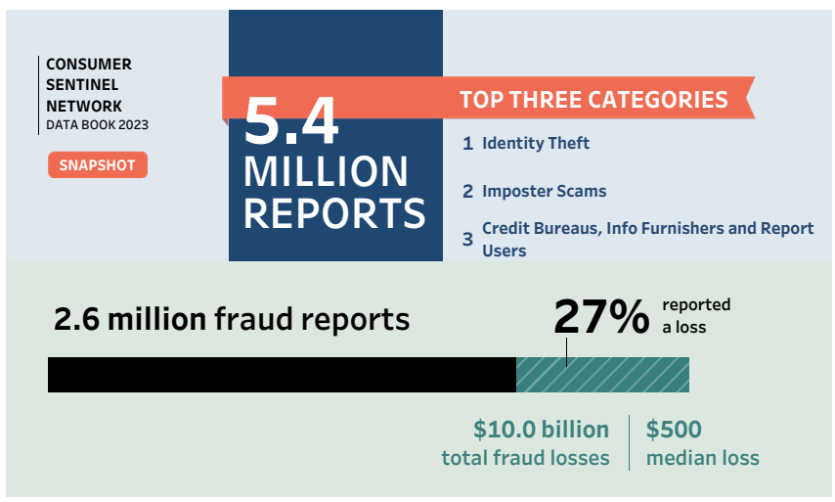
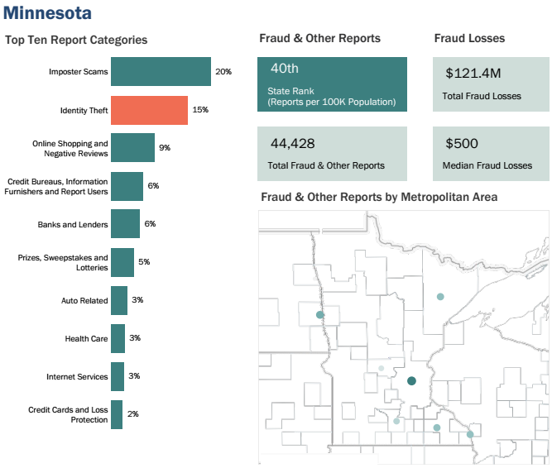
Federal Trade Commission Data

Slide 12
Federal Trade Commission Data

Slide 13
Why are older adults at risk for scams and consumer frauds?
Older adults may:
Income and assets
Health issues and grief
Socially isolated
Can be trusting and polite
Cognitive impairments
Receive care and support from another person
Fear the consequences of reporting the exploitation

Slide 14
Why older adults may not report financial exploitation?
Shame and embarrassment
Loyalty
Fear of retaliation
Fear of losing freedom
Fear of not being believed
Dependence
Denial
Self-blame
Lack of awareness

Slide 15
Common Themes of Imposter Scams
Pretend to be someone else
Prey on basic human emotions – such as fear or love and connection
Use high Pressure tactics

Slide 16
Credit Card Scams
What is this scam: This can happen when a caller says they need your credit card number to verify who you are to send you a prize.
What to do: Unless you initiate a call to a known merchant, never give out your credit card number for any reason.

Slide 17
Fake Charities
What is this scam:
This is when a thief poses as a real charity or makes up the name of a charity that sounds real to get money from you
Increase during the holiday season and around natural disasters and emergencies
What to do:
Ask for detailed information about the charity, including address and phone number
Research the charity online or through the Minnesota Attorney General’s Office

Slide 18
Grandparent Scams
What is this scam:
This can happen when you receive a phone call that sounds like a family member or grandchild.
The caller will tell you there is an emergency and ask for you to send money.
What to do: Pause and call another family member to confirm the details from the initial phone call

Slide 19
Investment Scams
What is this scam: A scammer will pitch a sure win investment, and they will need upfront money.
What to do:
Pause and investigate.
Call the Minnesota Department of Commerce to confirm the license of the investor.
Avoid high pressure sales pitches and offers that are too good to be true.

Slide 20
Lottery or Prize Scams
What is this scam: The scammer may call or email to tell you that you have won a prize through a lottery or sweepstakes. The scammer will ask you to pay the taxes and fees before getting the prize.
What to do: Never make and upfront payment for a promised prize.

Slide 21
Medicare and Social Security Scams
What is this scam: A scammer will call you and say they are from Medicare or the Social Security Administration. They will ask for your private information to update their file or to issue benefits.
What to do:
Never give out your private information.
Call the Office of the Inspector General to report any scams with Medicare or Social Security Administration.

Slide 22
Money Mule Scams
What is this scam: A scammer will ask you to receive or deposit money into your bank account. The scammer will then ask you to send money back to them before the check bounces.
What to do: Never agree to receive or send money for people you to do not know.

Slide 23
Romance Scams
What is this scam: A scammer will trick you into falling for them when they just want your money.
What to do:
Be smart about who you connect with and what information you share online.
Never give out your private information to a new love connection.

Slide 24
Remote Access Computer Scams
What is this scam: A scammer will claim to be from a computer company and tell you that your computer is infected with viruses. The scammer will ask you to download a program which then remotely controls your computer.
What to do: Do not give an unknown caller access to your computer.

Slide 25
Basics to Protect Yourself
When a deal sounds too good to be true, it is.
Don’t feel bad about screening your phone calls. It is okay to not answer.
Don’t feel bad about telling someone no thank you, good-bye, and hanging up.
Never give your credit card number or social security number to someone who calls you.
If you receive an email asking you to call a phone number or click on a link, go to the internet and confirm the phone number on the company website separate from that email or message.
No matter what the story is, only scammer will insist that the only way you can pay is by cash, gift card, cryptocurrency, payment app, or wire transfer.

Slide 26
How to support fraud victims
Step 1: Avoid Judgement
Step 2: Listen empathetically
Step 3: Remind them that fraud criminals are experts at deception and that they are not alone
Step 4: Help them report the crime to their bank, credit company, or the entity involved in the money transfer
Step 5: Help them change their passwords or freeze their credit if the scammers have their personal information
Step 6: Help them file a fraud report with a federal agency such as the FTC, SEC or Internet Crime Complaint Center (IC3)
Step 7: Be available to discuss any new suspicious solicitations that they may receive
Step 8: Help them identify a financial advocate to keep their money safe from future exploitation

Slide 27
Resources
Federal Government Resources
Federal Trade Commission – 1-877-382-4357
Federal Bureau of Investigation‘s Internet Crime Complaint Center – www.ic3.gov
National Elder Fraud Hotline within the Department of Justice – 1-833-372-8311
Social Security Office of Inspector General (800) 269-0271
United States Postal Inspection Service – Criminal Investigation Service Center (877) 876-2455
Minnesota Government Resources
Minnesota Attorney General – 651-757-1496
Senior Linkage Line (800) 333-2433
MN Department of Commerce (651) 539-1500
Other Resources
Your local police department
Your financial institution
Better Business Bureau (651) 699-1111
Charity Review Council of Minnesota (651) 224-7030
AARP®: Fraud Watch Free Helpline: 877-908-3360

Slide 28
MMLA Minneapolis Office’s
Senior Law Project
Need help?
Statewide Centralized Intake
1-877-696-6529 (1-877-MY-MN-LAW)
MMLA intake line at 612-334-5970
Monday through Friday - 9:30 am-11:30 am
Monday through Thursday – 1:30 pm – 3:30 pm

Slide 29
Thank you!

